Slide 1

Job Help
Presentation on
A Marketplace For Freelancers
Presented By
UNDER THE GUIDENCE OF
Prof.Yogita Vishwakarma
Aditya .k. Thakur
Swapnil Jichkar
Dheeraj Dawande
Faisal Ahmad
3 April 2025

Slide 2
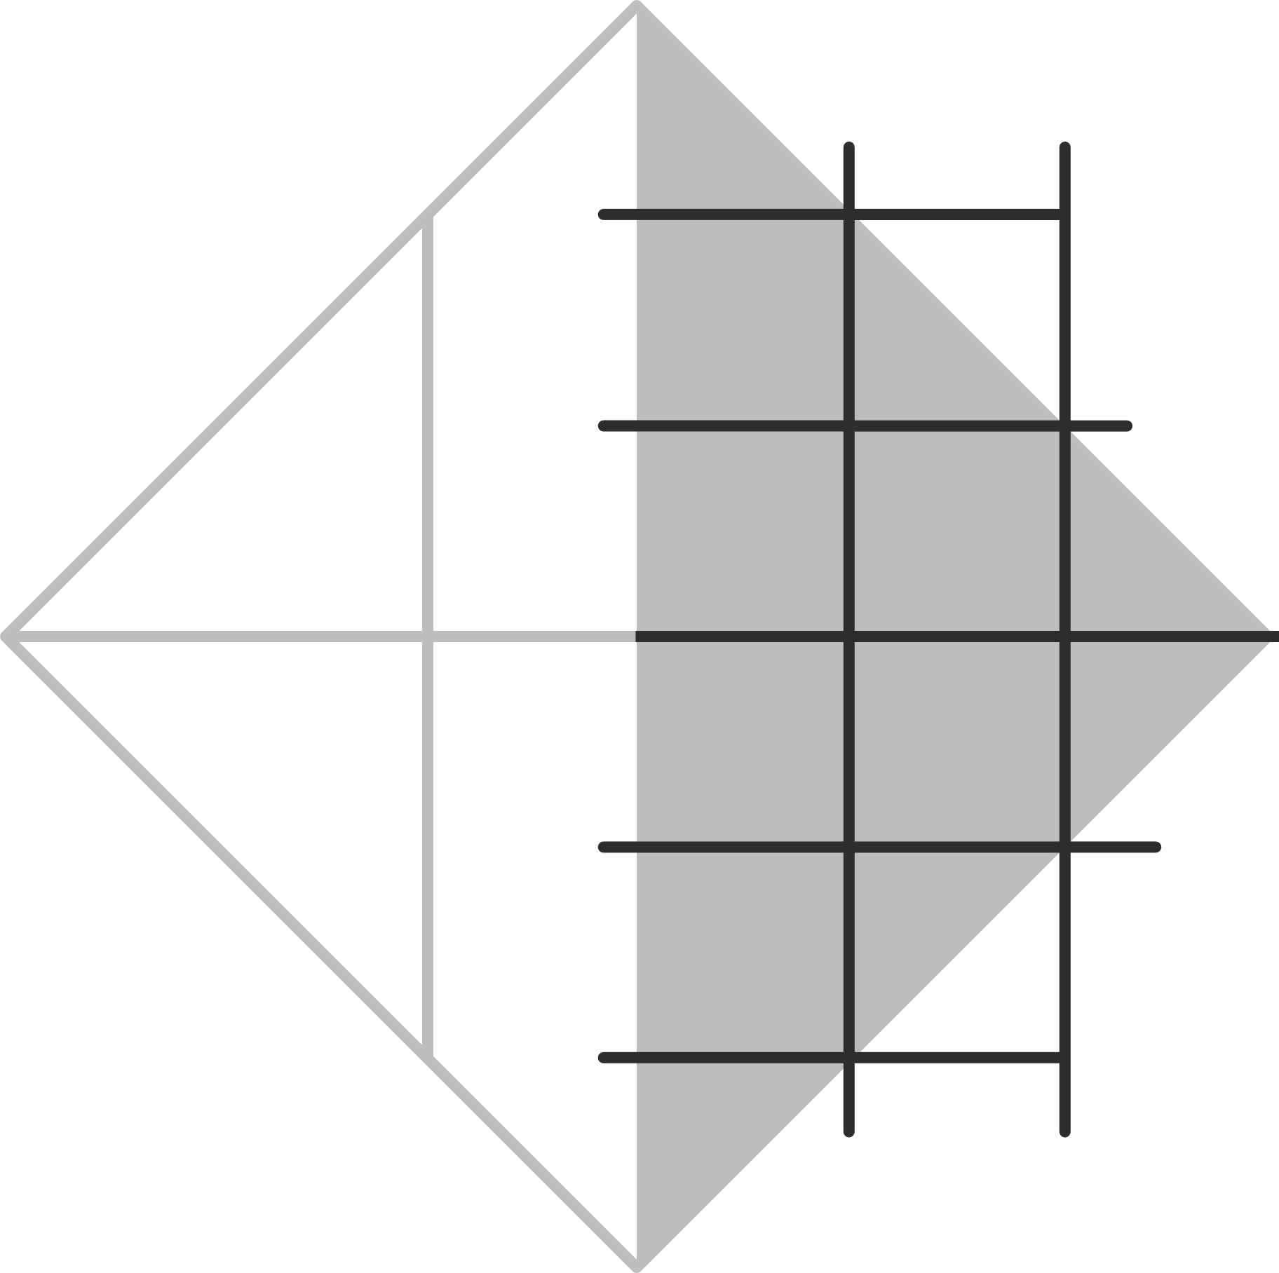

Job Help
LIST OF CONTENT
Introduction
Problem Statement
Solution domain
Prototype application
Technology which is used
Future Scope
2

Slide 3


Job Help
INTRODUCTION
Introducing “JobHelp” A platform where you can showcase you skills and projects.
A part from that you can hire a freelancer or find a perfect client.
TechArt is a platform that connecting skilled freelancers with trusted and authorised clients from around the world.
3

Slide 4
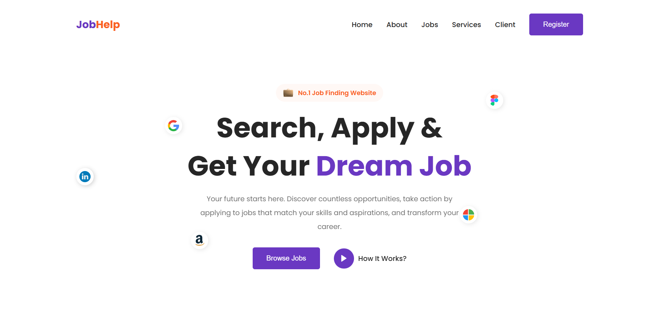
Job Help
SCREEN LAYOUT
HOME PAGE
6

Slide 5
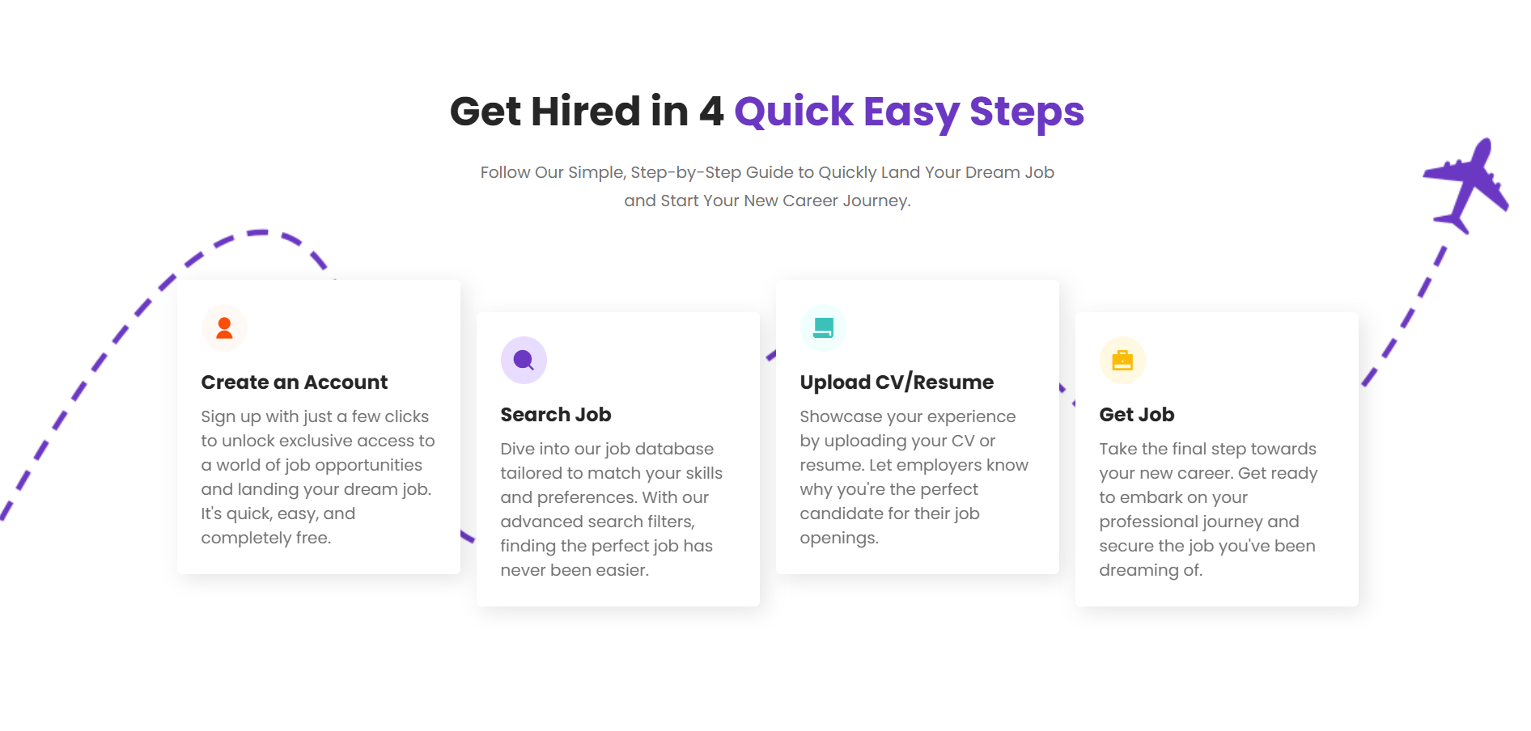
Job Help
SCREEN LAYOUT
HOME PAGE
7

Slide 6
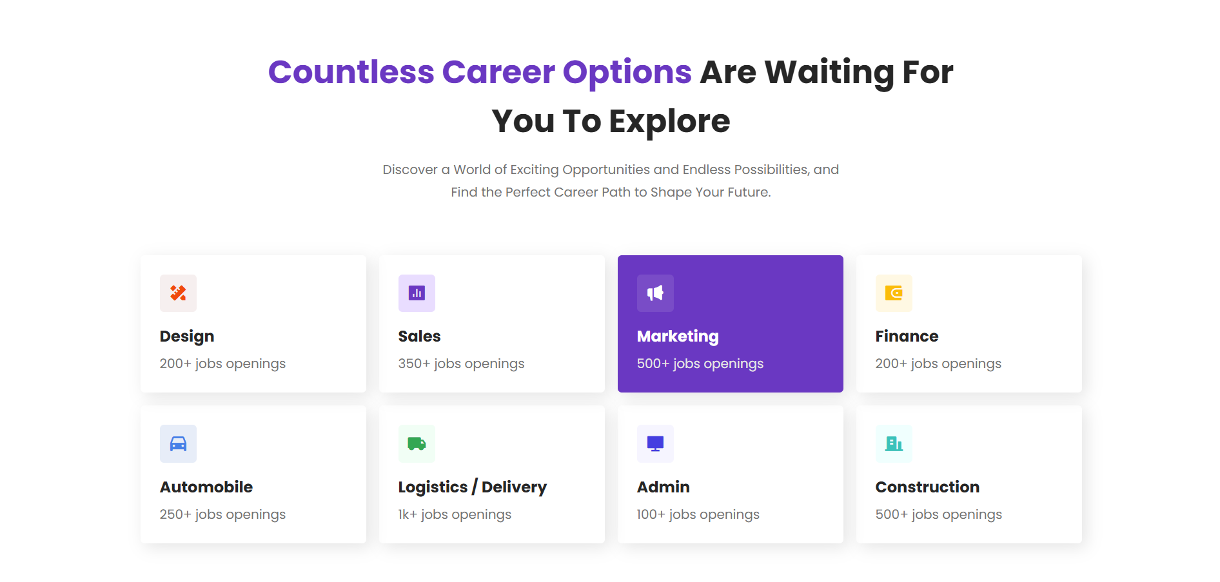
Job Help
SCREEN LAYOUT
HOME PAGE
8

Slide 7
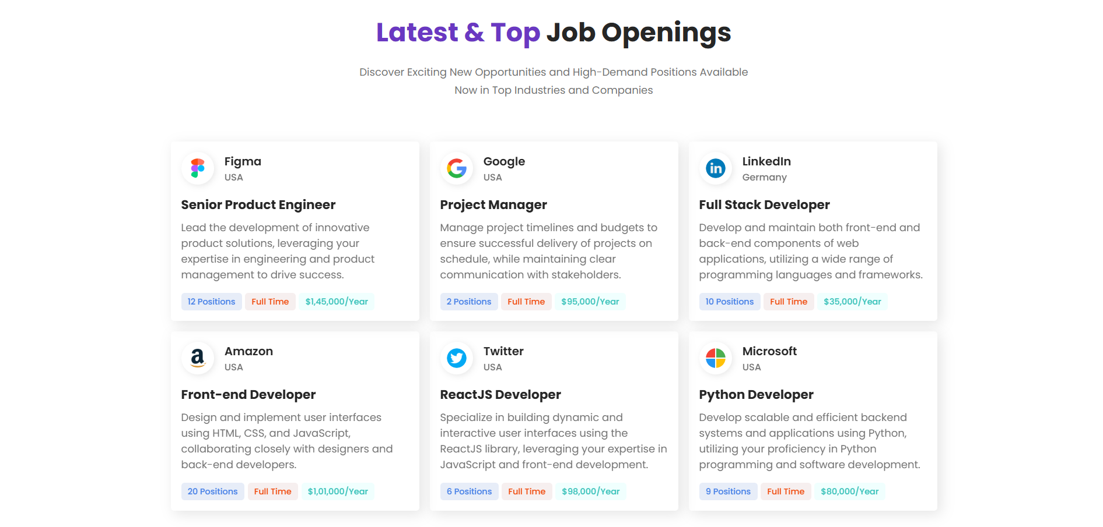
Job Help
SCREEN LAYOUT
HOME PAGE
9

Slide 8

Job Help
SCREEN LAYOUT
HOME PAGE
10

Slide 9
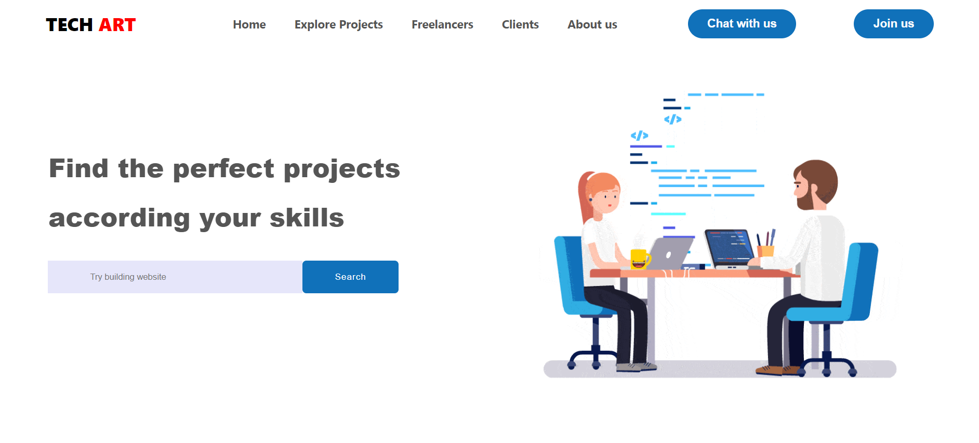
Job Help
SCREEN LAYOUT
HOME PAGE
11

Slide 10
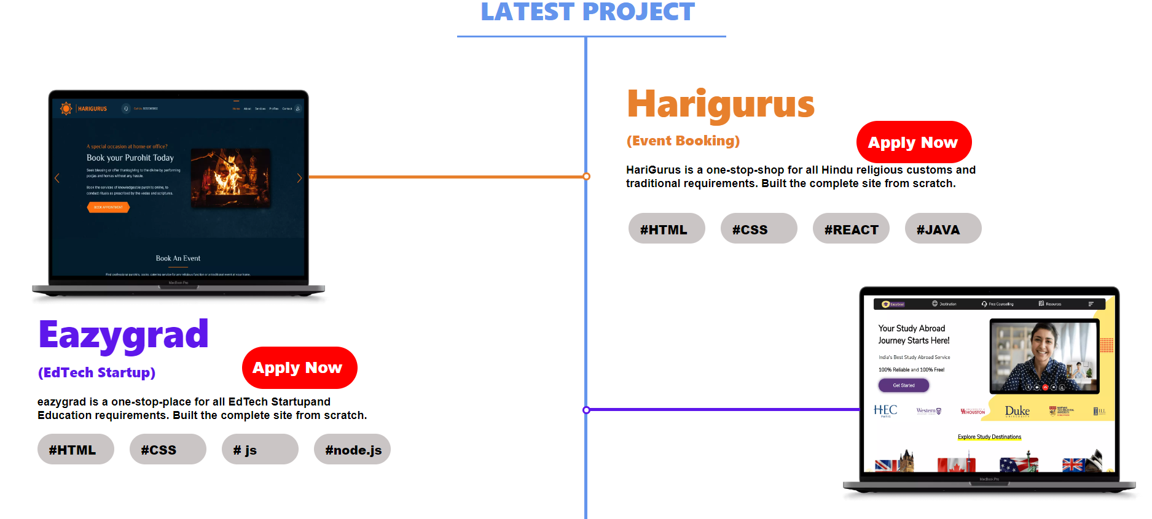
Job Help
LATEST PROJECT
12

Slide 11
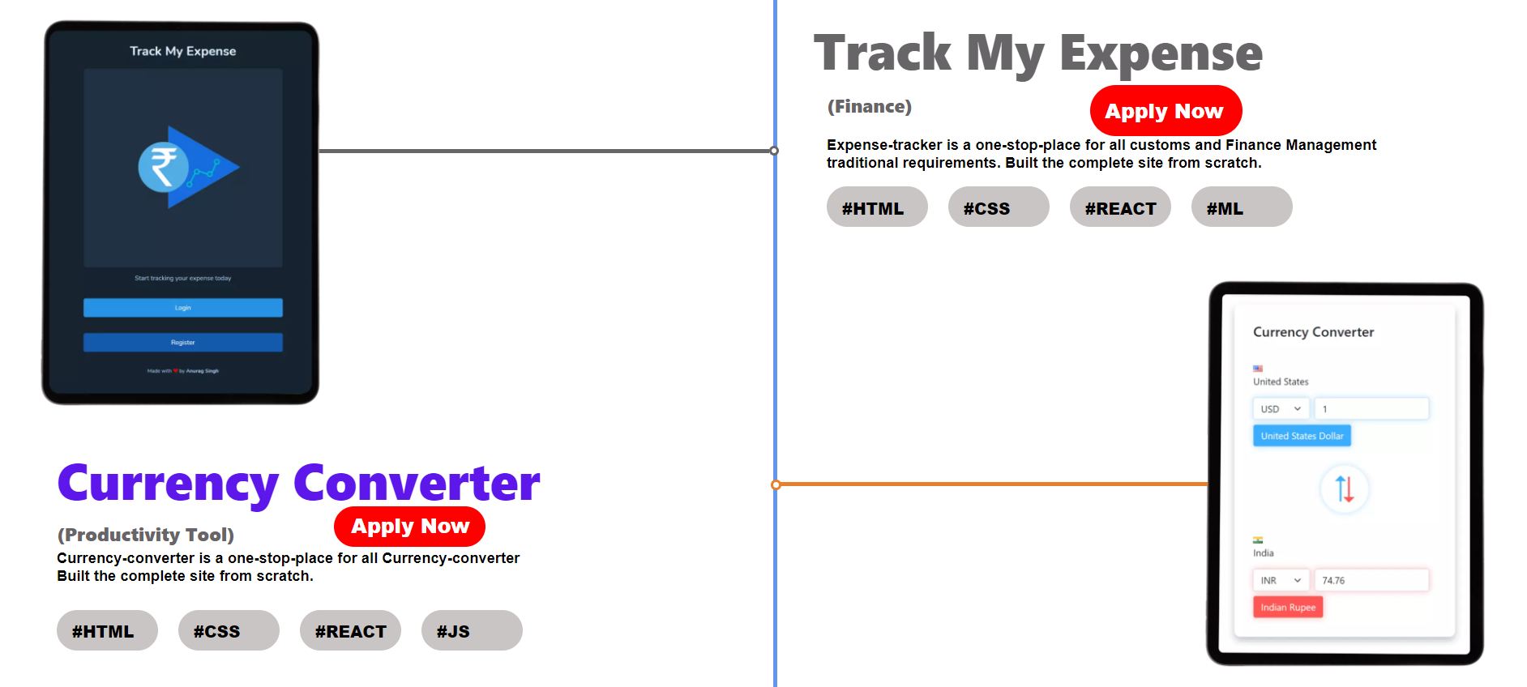
Job Help
LATEST PROJECT
13

Slide 12
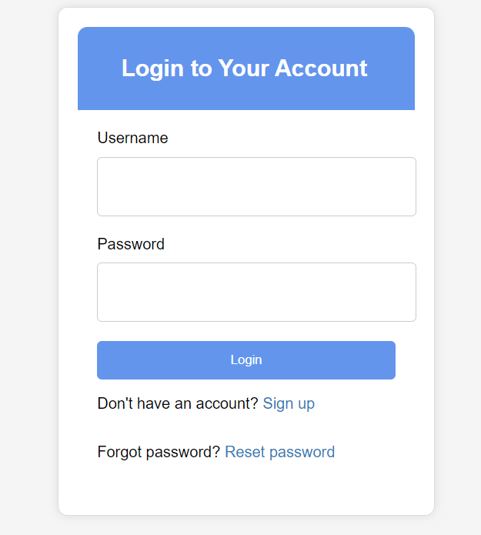
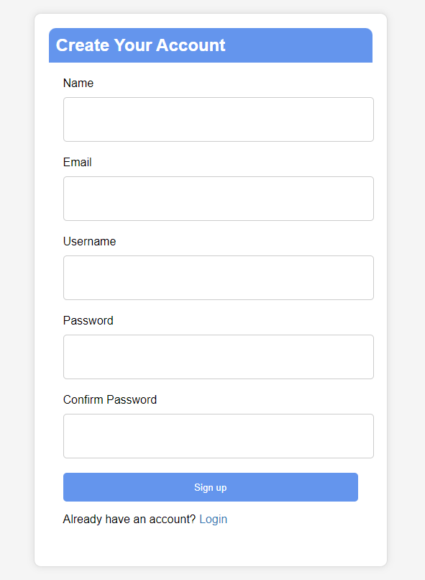
Job Help
LOGIN/SIGNUP PAGE
OR
14

Slide 13
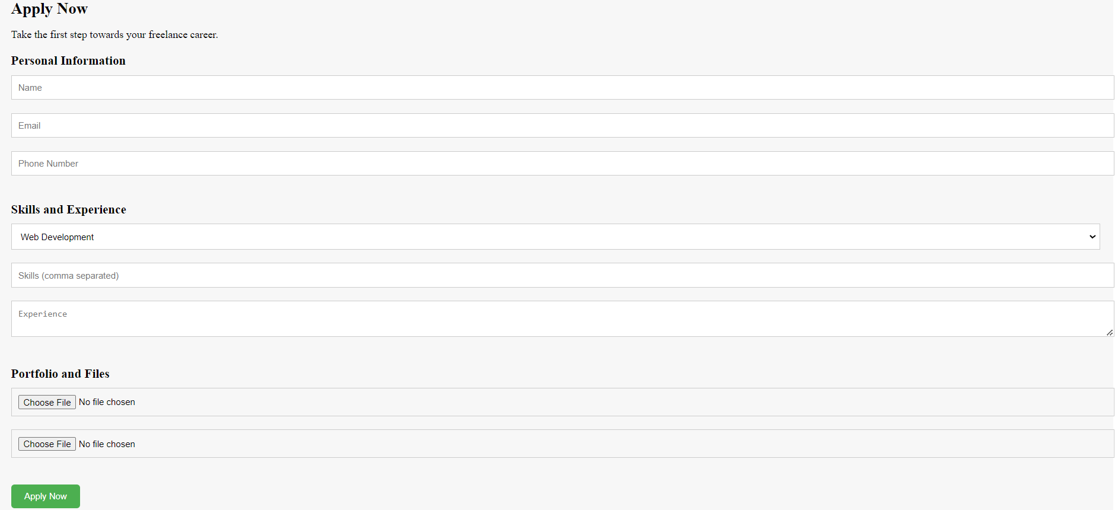
Job Help
APPLY NOW PAGE
15

Slide 14
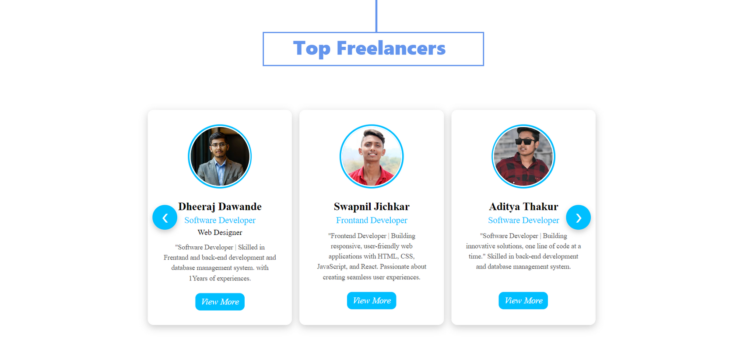
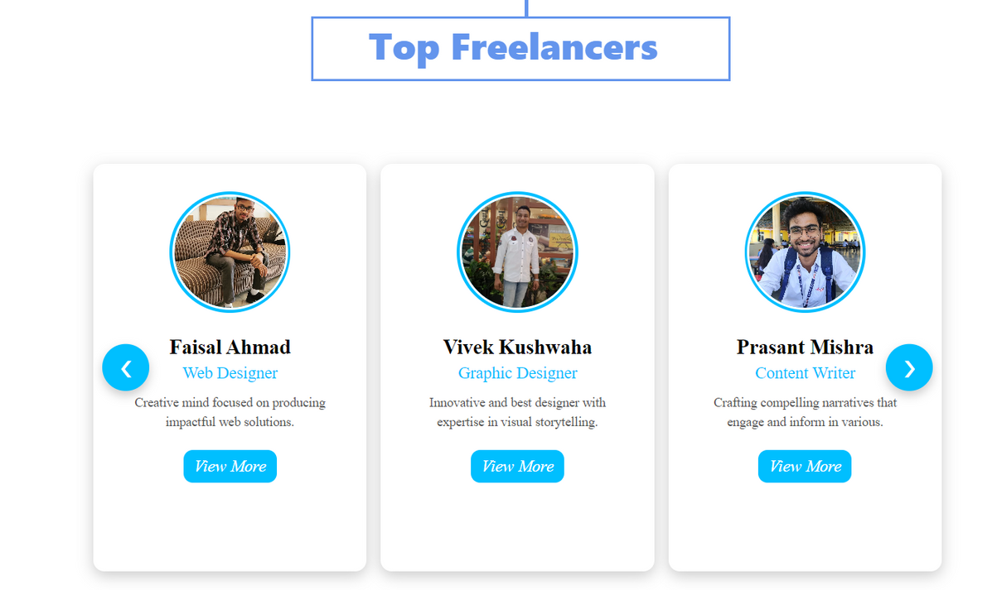
Job Help
TOP FREELANCERS SECTION
16

Slide 15
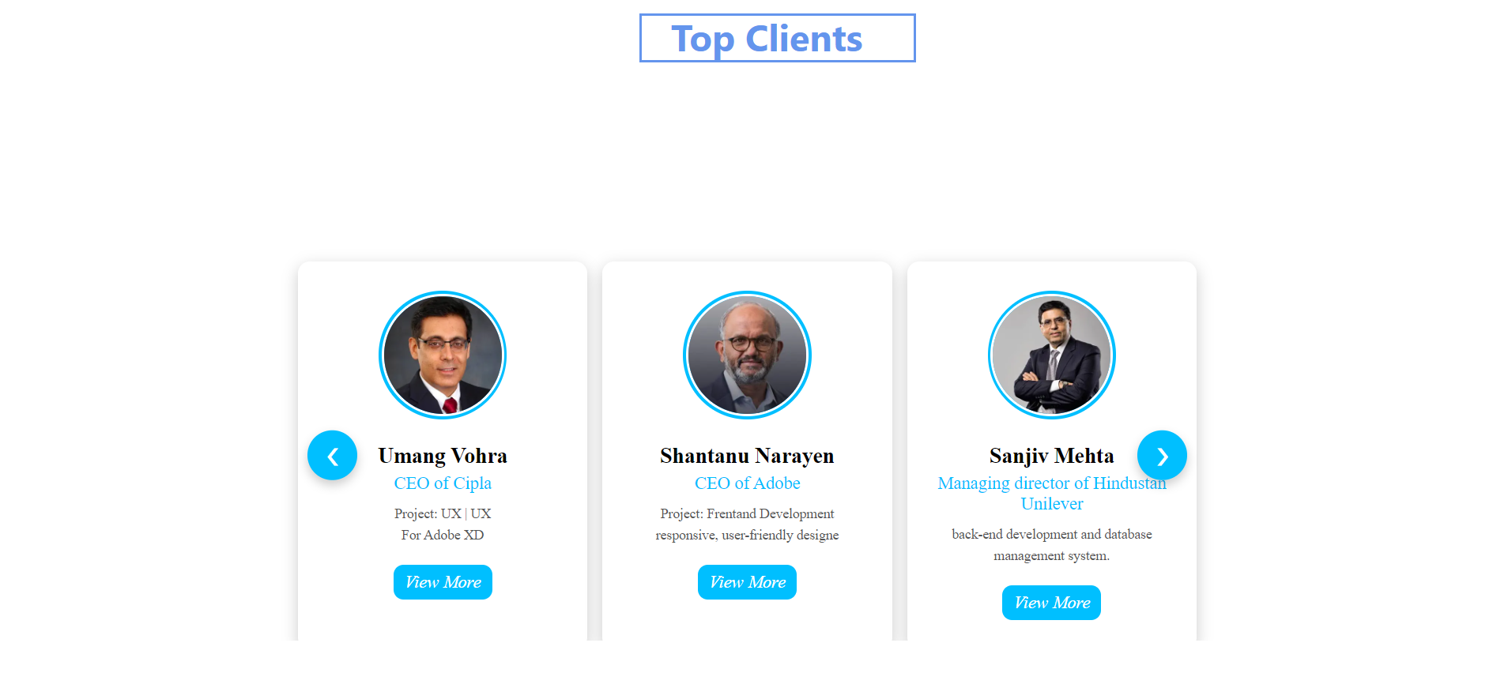
Job Help
TOP CLIENT SECTION
17

Slide 16
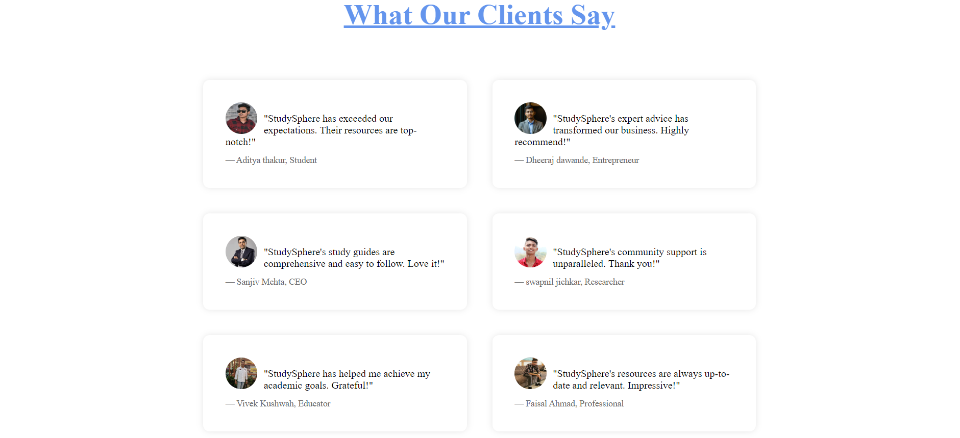
Job Help
TESTIMONIAL SECTION
18

Slide 17
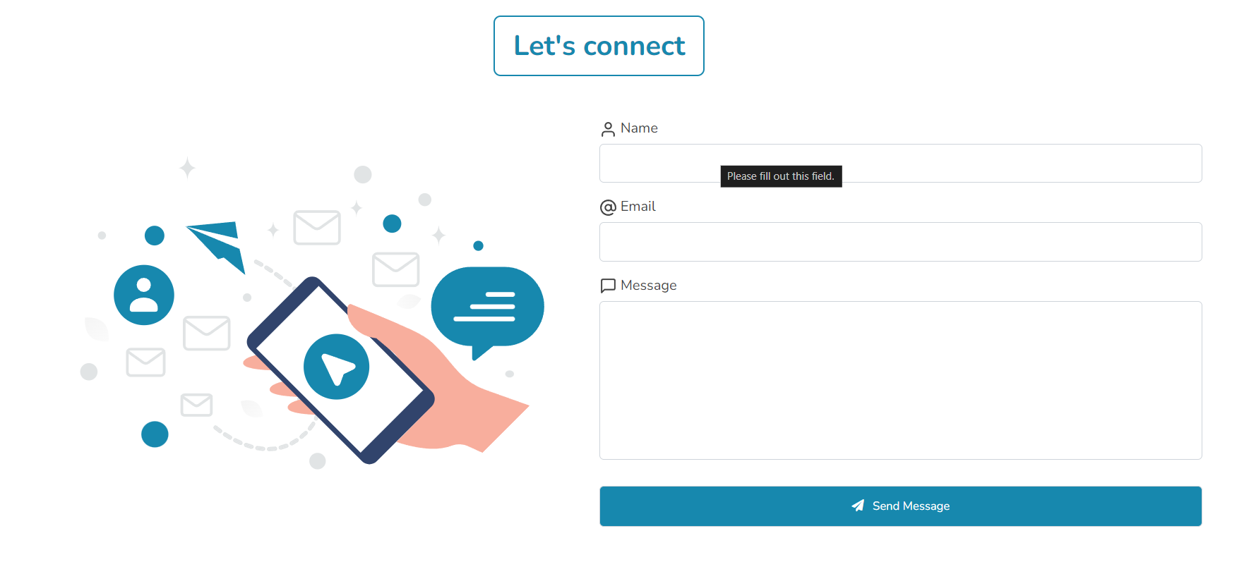
Job Help
CONTECT SECTION
19

Slide 18

Job Help
FOOTER SECTION
20

Slide 19
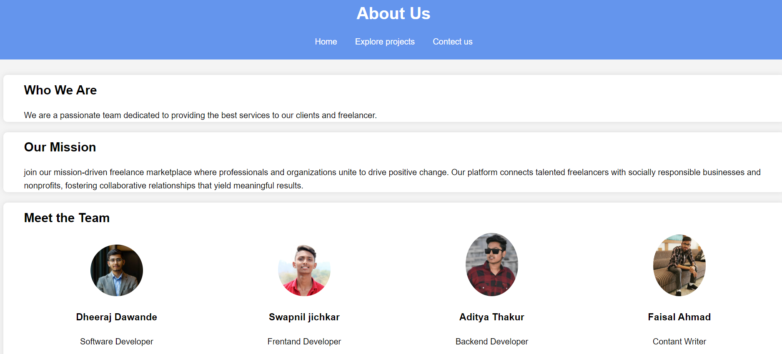
Job Help
ABOUT PAGE
23

Slide 20
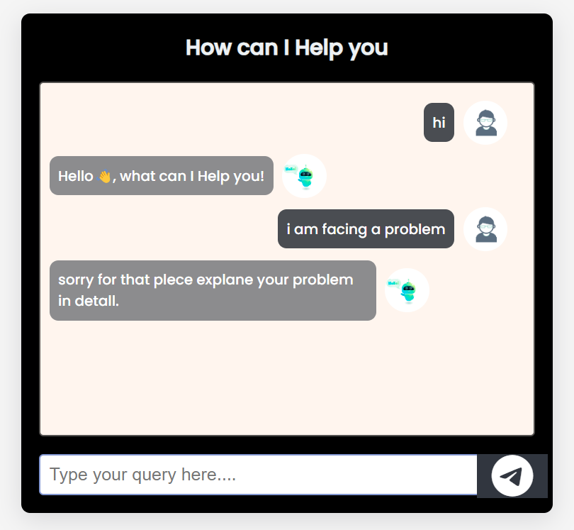
Job Help
AI FOR SOLVING QUERY
24

Slide 21
Job Help
TECHNOLOGY WHICH IS USED
HTML – hypertext markup language (HTML) is used to build the structure of our website.
CSS- Cascading Style Sheets (css) is used to style and layout the webpages.
JS- javascript is used to make webpages interactive and give website functionality .
Netlify – It is used host our website online.
Ai chat feature – it is used for automate chat support and solve queries .
25

Slide 22


Job Help
Thank you
for listening

